Slide 1
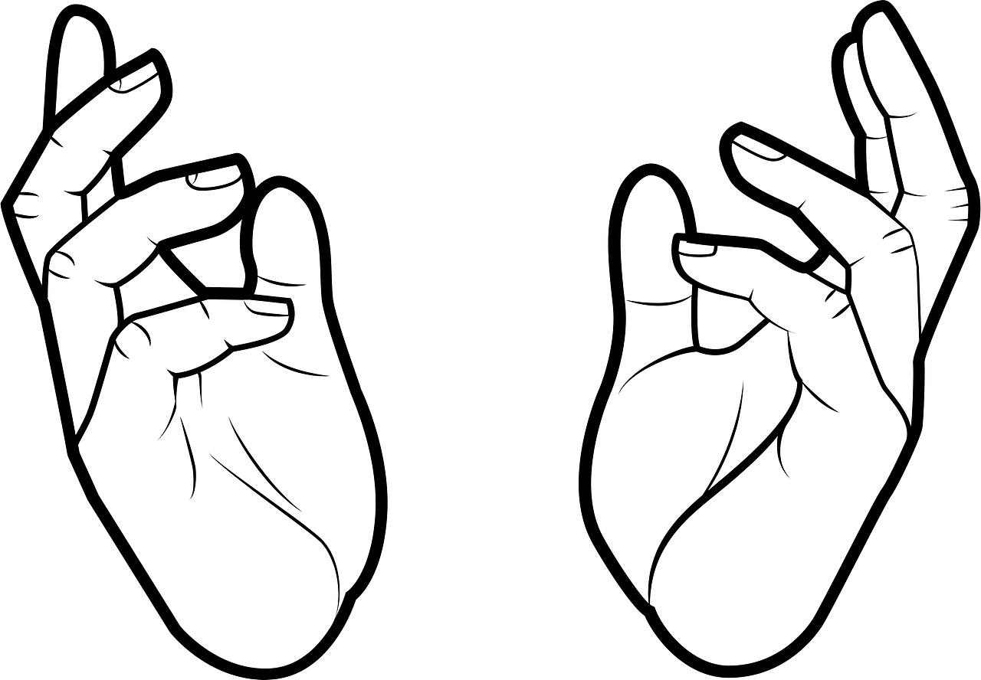

one
SIGN LANGUAGE
RECOGNITION
Using Convolutional Neural Network
System of morals are only a sign-language of the emotions.
~Friedrich Nietzsche

Slide 2

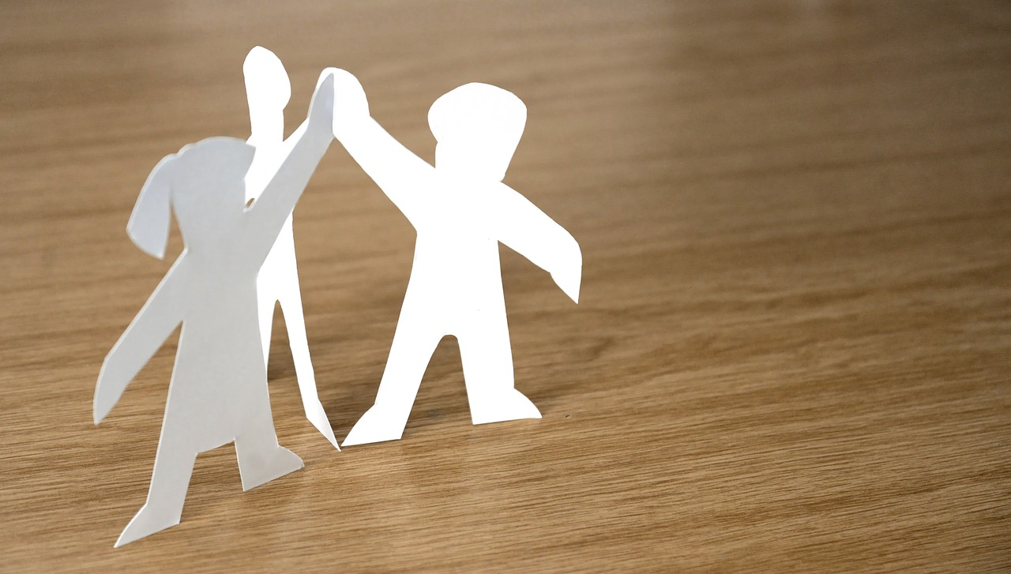
two
SIGN LANGUAGE
RECOGNITION
Sohela Showrin
2104010202199
Rahin Toshmi Ohee
2104010202204
Jahirul Islam Rakib
2104010202209
Durjoy Nath
2104010202222

Slide 3
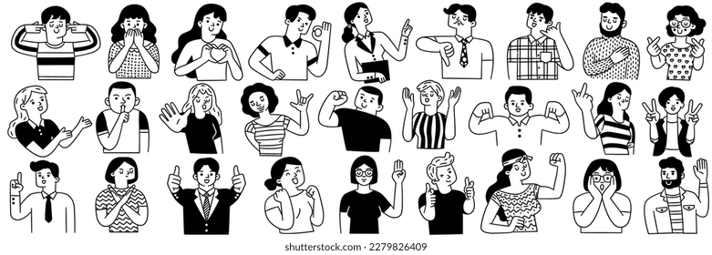
three
AGENDA
four
eight
INTRODUCTION
METHODOLOGY
five
nine
OBJECTIVE
RESULT ANALYSIS
six
ten
FUTURE RECOMMENDATIONS
ASL
seven
eleven
CONCLUSION
MODEL ARCHITECTURE

Slide 4


four
INTRODUCTION
Sign Language and
Its Importance
Sign language is more than just a language. Sign language is a visual communication system that uses hand gestures, facial expressions, and body movements to convey meaning.

Slide 5

five
OBJECTIVES
Some objectives of ours:
Accurate Gesture Recognition
Robust Feature Extraction
Enhancing Accessibility & Inclusion
Dataset Expansion & Generalization
Every goal should be smart Specific, Measurable,
Achievable, Relevant, and Time-bound.

Slide 6
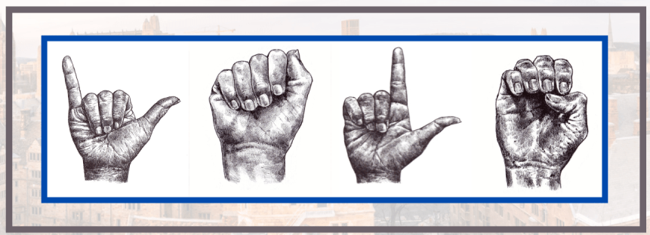
six
American
Sign Language
Why choose ASL?
ASL is widely used and well-documented, making it ideal for sign language recognition. Its distinct hands movements enhance accuracy.
Some of the most widely used sign languages include:
American Sign Language (ASL)
British Sign Language (BSL)
Indian Sign Language (ISL)
International Sign (IS)

Slide 7
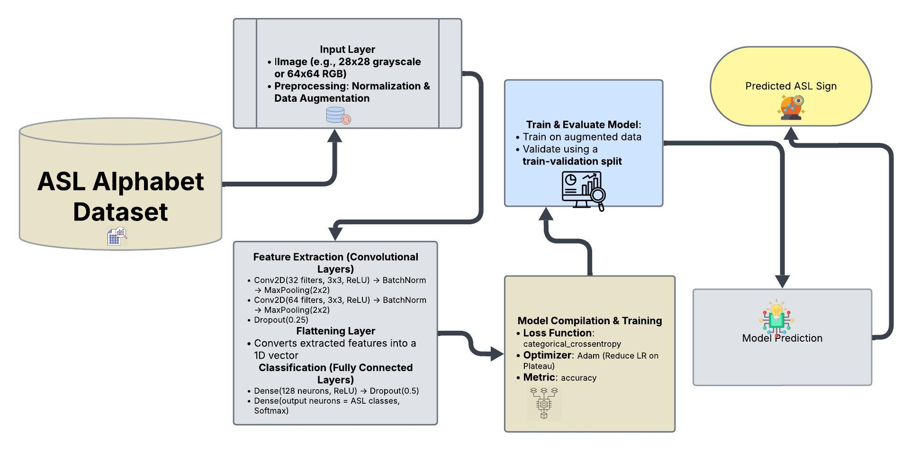
seven
MODEL
ARCHITECTURE

Slide 8
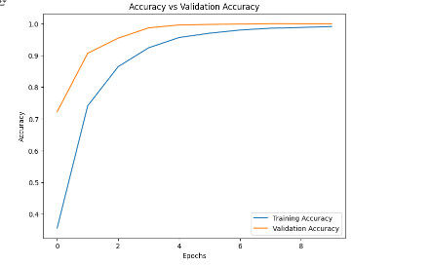
eight
METHODOLOGY
Convolutional Layers : 03
Each convolutional block contain - convo 2D layer, batch normalization, max pooling layer, drop out layer
Activation Functions : ReLU
Learning Rate : 0.001
Data Collection
Model Development
Model Evaluation
Implementation and Deployment
Model Training
Data Pre-processing

Slide 9


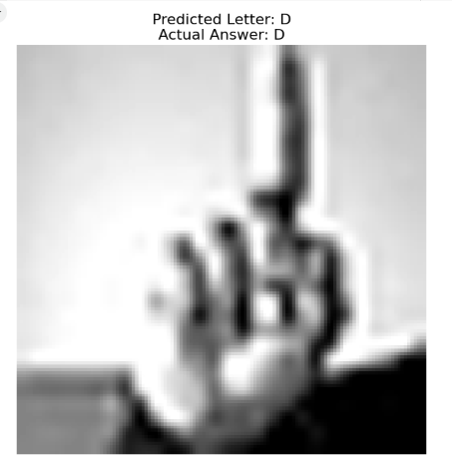
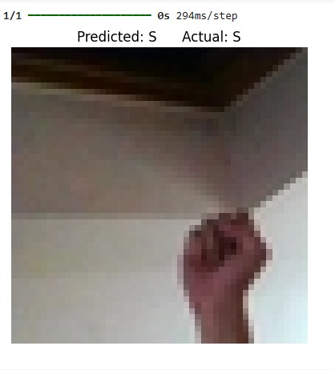
nine
RESULT ANALYSIS
By training the model we got :
Metric | Value
Train_Accuracy | 99.03%
Train_loss | 3.02%
Val_accuracy | 99.98%
Val_loss | 0.33%
Test_Accuracy | 90.33%
Test_loss | 31.77%
Result Demo 1
Result Demo 2

Slide 10

ten
FUTURE RECOMMENDATIONS
Improving Model Accuracy & Robustness
Real-Time Performance Optimization
Multilingual and Cross-Language Recognition
3D Sign Language Recognition
User Feedback & Continuous Learning

Slide 11
eleven
CONCLUSION
Sign language recognition using CNN enhances communication for the deaf community through AI-driven gesture recognition. Despite challenges like accuracy and multilingual support, advancements in deep learning and real-time processing continue to improve performance. Future innovations in AI and 3D recognition will further enhance accessibility and inclusivity.
Sign language is the noblest gift God has given to deaf people.
~George Veditz

Slide 12

twelve
I must say I'm not 100% fluent in Sign Language, but I am working on it!
~Sundra Oakley

